Slide 1
Formatting visualization & analysis
.

Slide 2
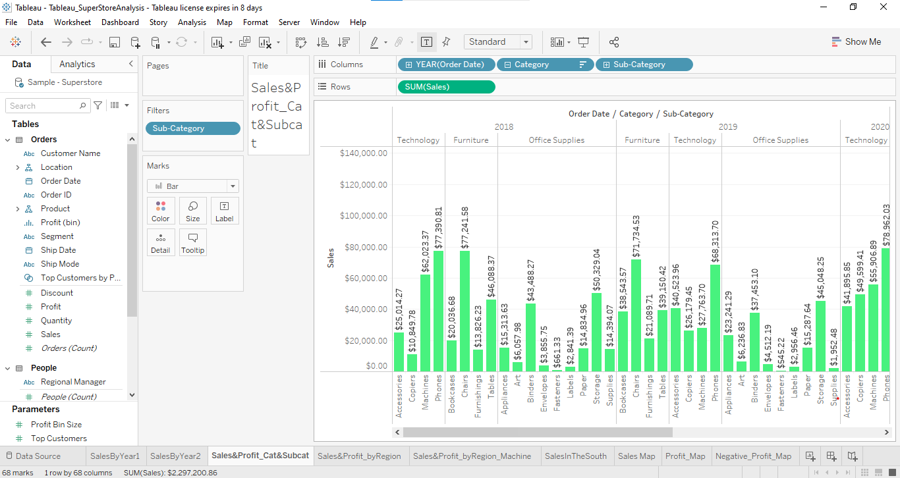
1.Find the profit and sales for each subcategory of every type of product.

Slide 3
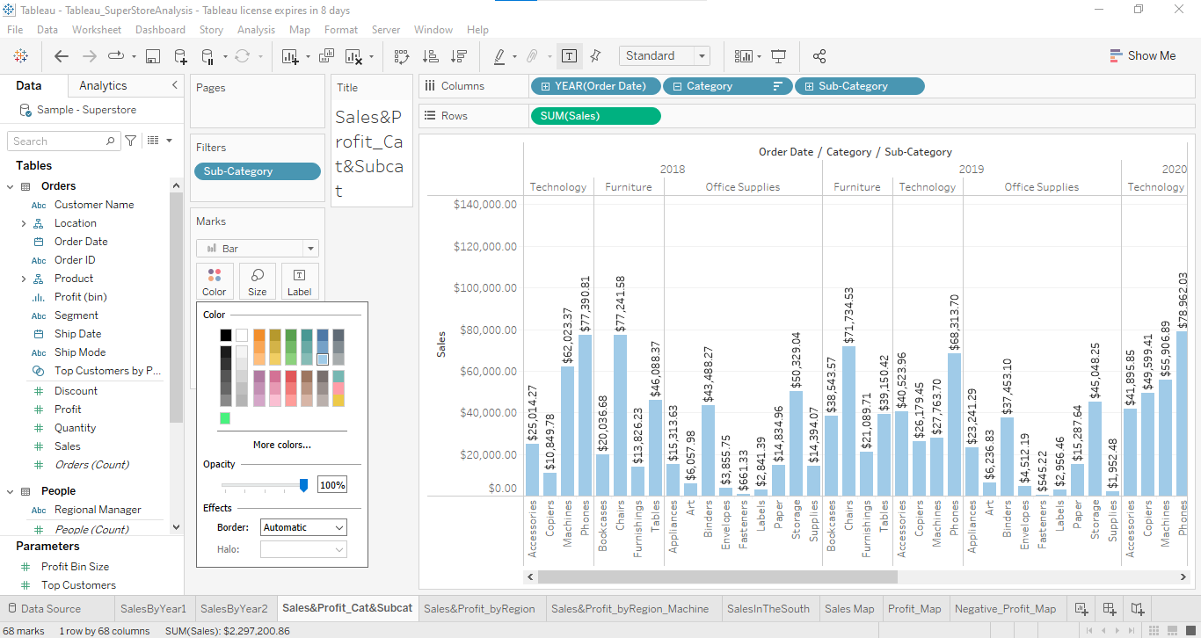
2. Which subcategory has highest profit in the year 2019.
By looking at graph we can conclude that chair subcategory has highest sale of $71,734.53
3. In case 1, change the color of the view from the Marks card.

Slide 4
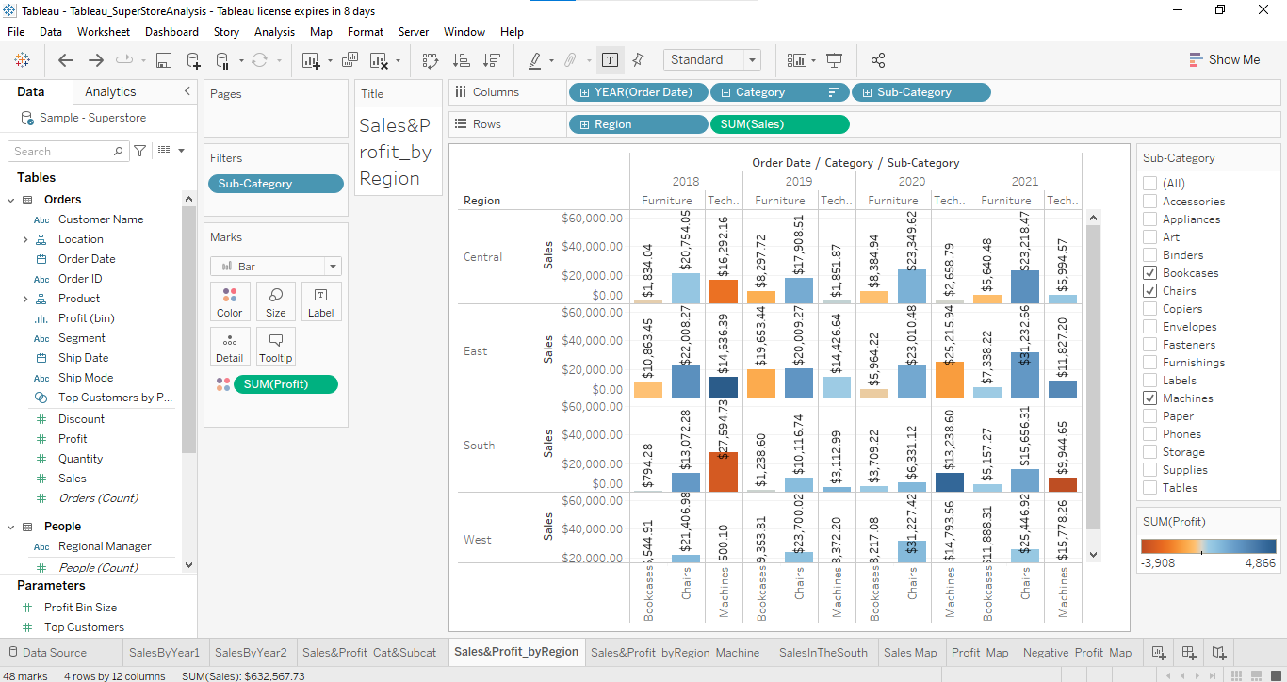
In the view, in the Sub-Category filter card, clear all of the check boxes except Bookcases, Machines, and Tables to have closer look on each value

Slide 5
5. Find out the key insights about in which year bookcases and machines were profitable and unprofitable.
In the year of 2018 we have highest profit of $14,636.39
And in the year 2018 we have highest unprofit of $-3,254
6. Show the sales region wise for every subcategory and category and every year.

Slide 6
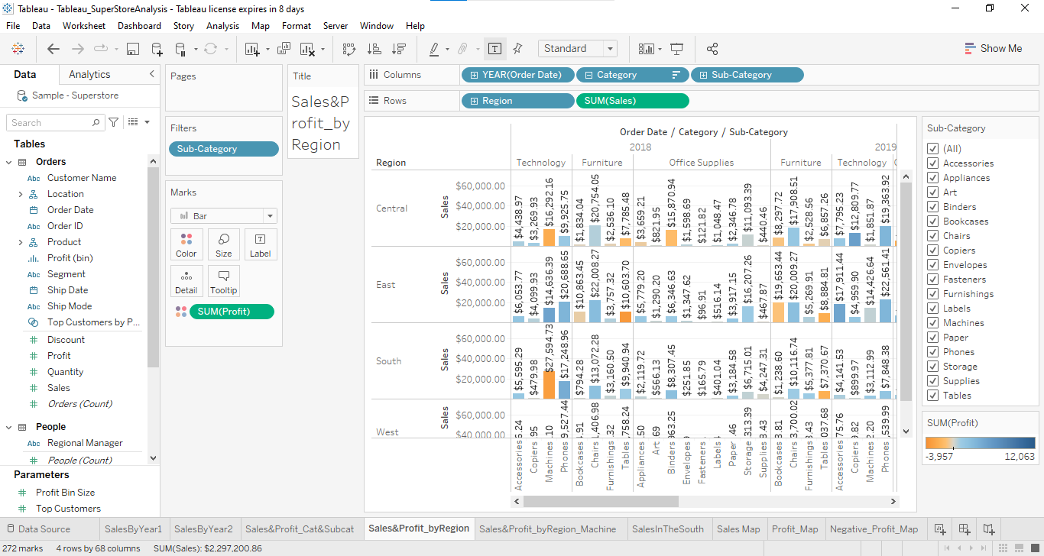

Slide 7
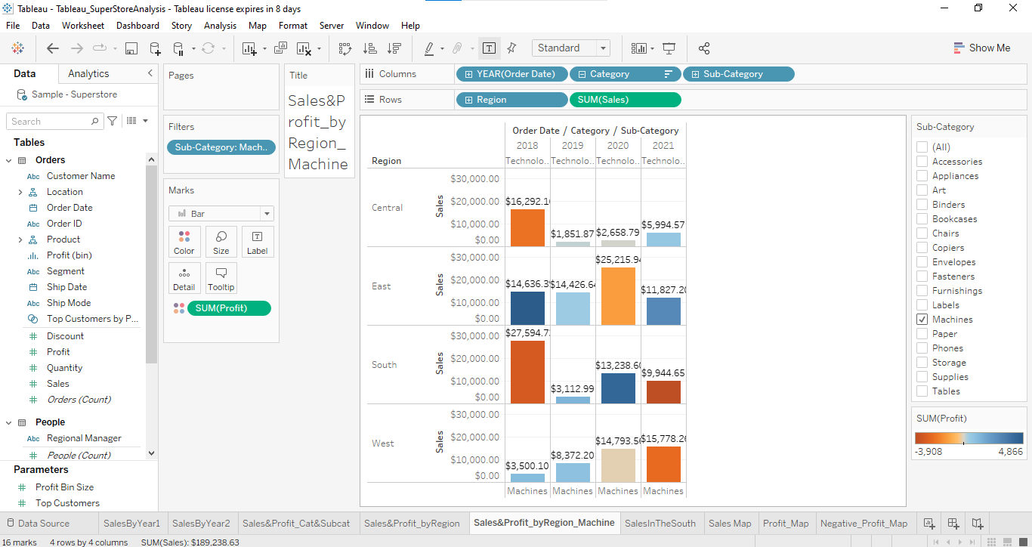
7. Duplicate your worksheet and check sales region vise for Machine type subcategory.

Slide 8
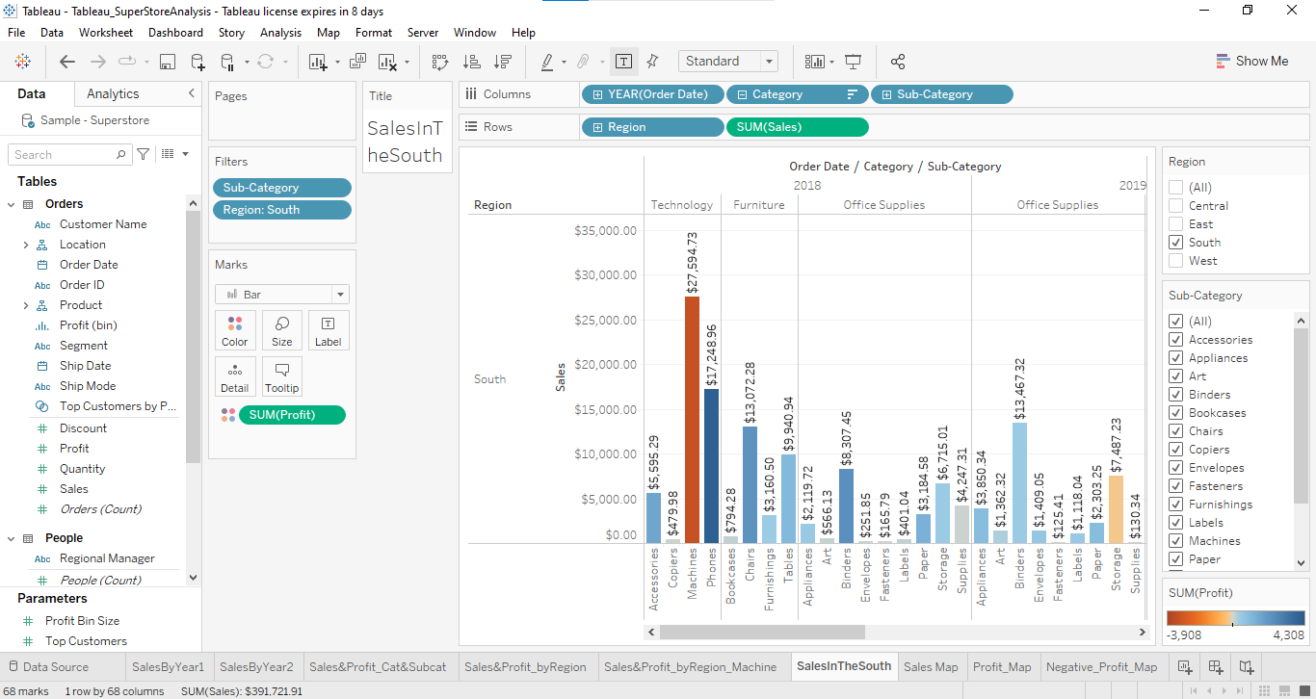
8. In which region you are reporting a higher negative profit overall than in your other regions.

Slide 9
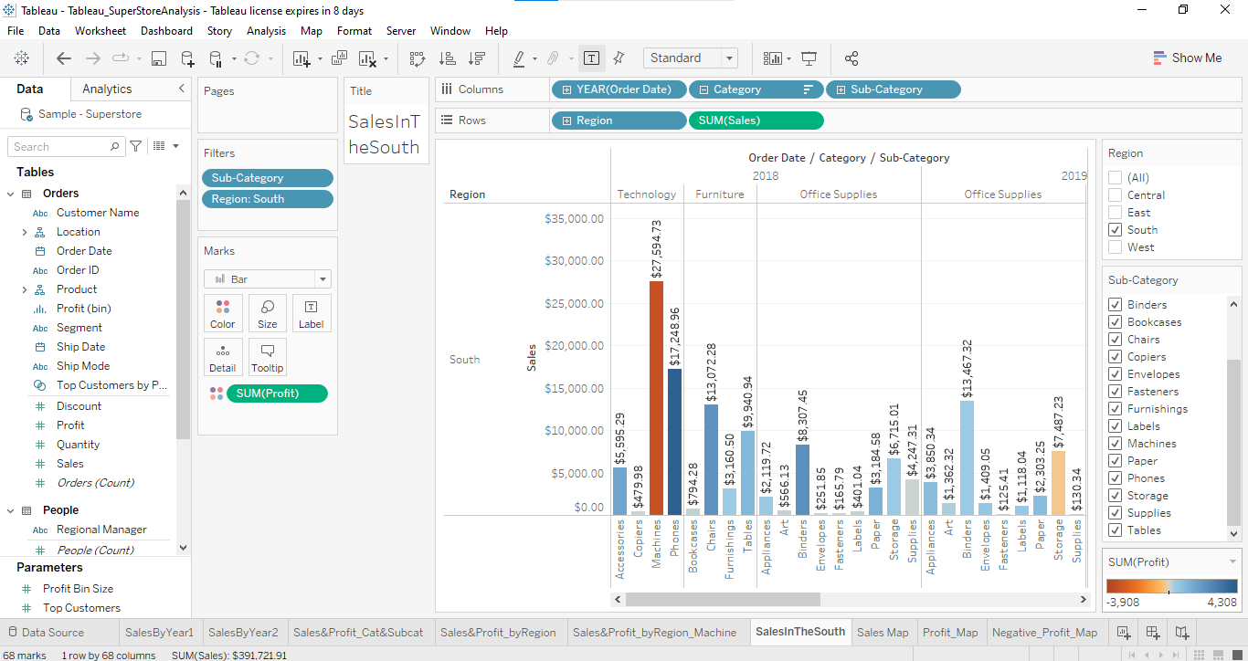
9. Show your view for Sales in the South for all subcategory.

Slide 10
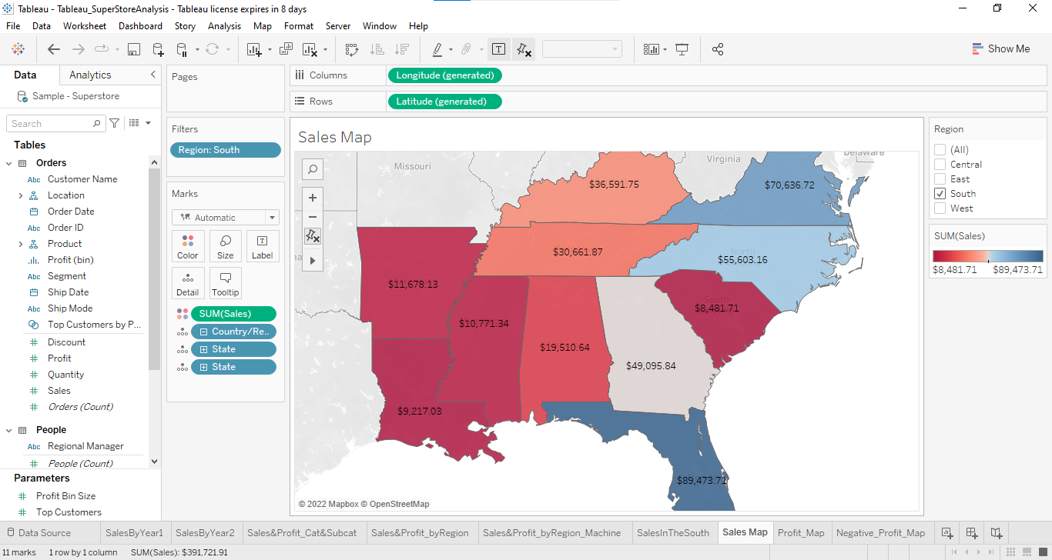
10. Which subcategory has highest overall negative profit in the south region.

Slide 11
11. Take some decisions to improve profit in the south.
To improve the sale and profit in south we have to take action on customer satisfaction and have to give them complete information about products means product validity, uses, warranty and its features through advertising and marketing etc. or else we have give some offers on the products remembering our income of that product .
12. Rename your worksheet.
13. Save your workbook.

Slide 12
